Slide 1
Experiment-Free Exoskeleton Assistance Via Learning In Simulation
Paper Review By Dominik Zielinski for BME 452
Original paper at https://doi.org/10.1038/s41586-024-07382-4

Slide 2
Motivation for this work.
Exoskeletons work better when personalized to the user
Personalization today requires lengthy in-lab experiments with each subject
This paper's claim: skip the human experiments entirely
You can learn the controller in simulation, deploy directly in the real world

Slide 3
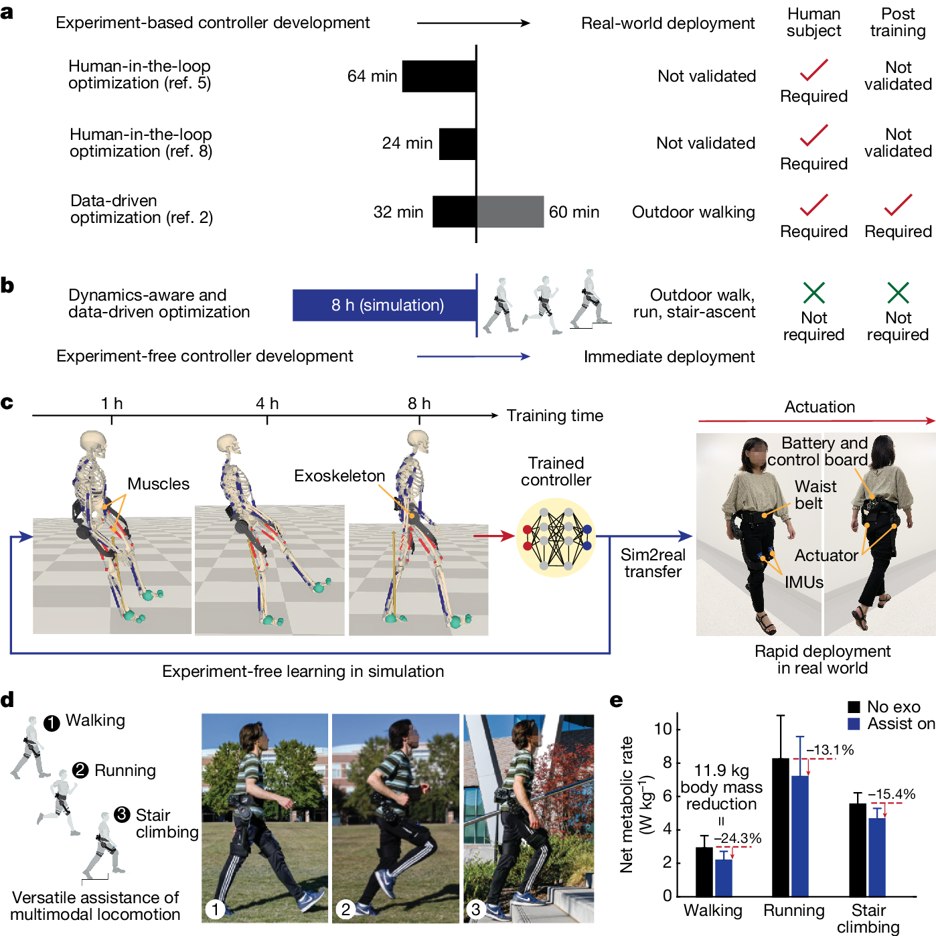
Methods (Fig 1)
Review of previous work
How the current work compares
Simulation Training (left) and immediate deployment (right)
Example of assistance for walking, running, and stair climbing
Reduced metabolic cost for walking, running, and stair climbing (Results preview)

Slide 4
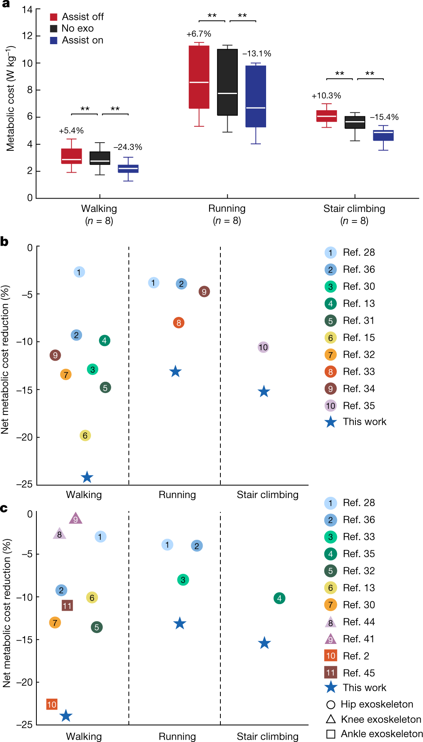
Results (Fig 5a)
Calculated metabolic cost across
3 conditions (Assistance off, No exoskeleton, Simulated assistance given)
3 tasks (Walking, Running, and Stair Climbing)

Slide 5
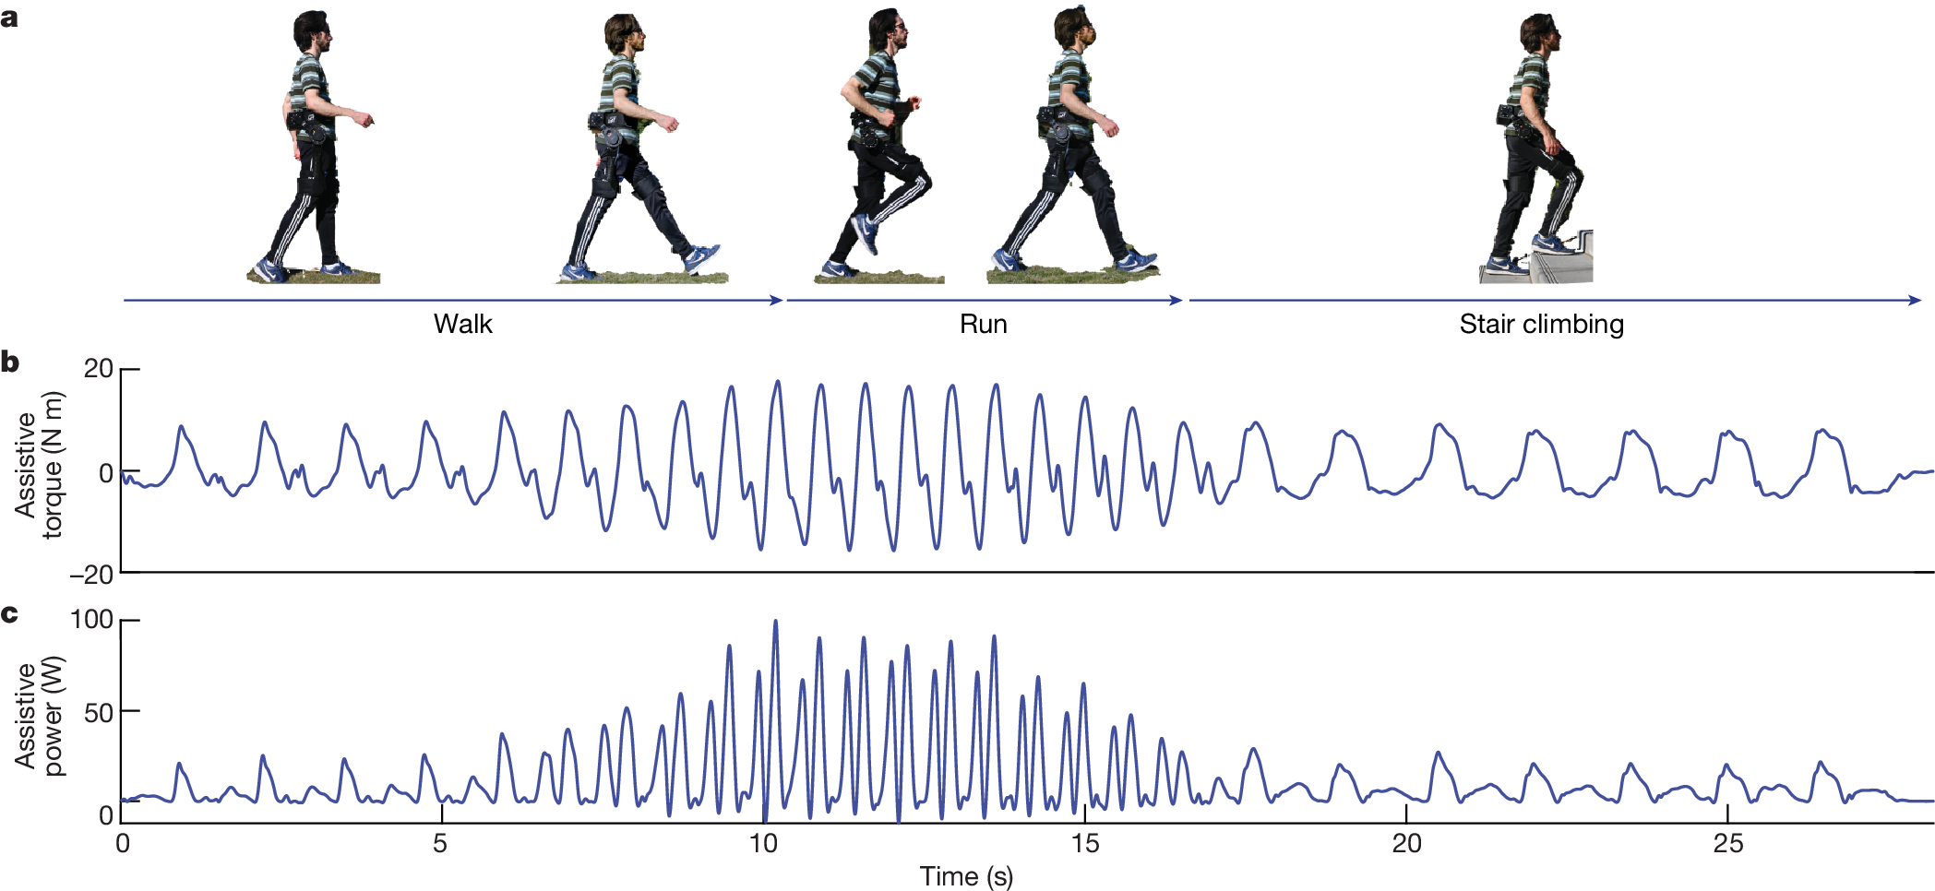
Results (Fig 4)
How assistive torque was implemented
Visual diagram of task transitions during a single trial
Assistive torque
Assistive power

Slide 6
Results (Fig 5c)
Calculated metabolic cost compared to other work
Across walking, running, and stair climbing
Provides type of exoskeleton used as well
Mix of Hip exo, Knee exo, and Ankle exo

Slide 7
Key takeaways
A controller trained entirely in simulation can transfer directly to real hardware with minimal to no human calibration
The learned controller outperforms all prior portable exoskeletons for walking, running, and stair climbing
Sim-to-real transfer for wearable robots is a solved or near-solved problem

Slide 8
Key takeaways
A controller trained entirely in simulation can transfer directly to real hardware with minimal to no human experiments
The learned controller outperforms all prior portable exoskeletons for walking, running, and stair climbing
Sim-to-real transfer for wearable robots is a solved or near-solved problem
These results were so good, they motivated a derivative work

Slide 9
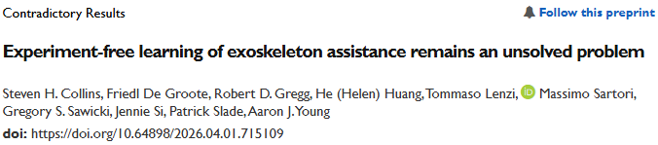

Slide 10




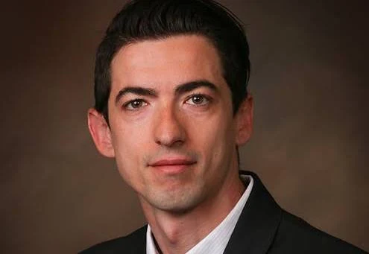





Steven H. Collins
Stanford University
Friedl De Groote
University of Leuven
Robert D. Gregg
University of Michigan
He (Helen) Huang
The University of North Carolina at Chapel Hill
Tomasso Lenzi
University of Utah
Massimo Sartori
University of Twente
Gregory S. Sawicki
Georgia Tech
Jennie Si
Arizona State University
Patrick Slade
Harvard University
Aaron J. Young
Georgia Tech
Various leading experts from the field of robotic exoskeletons
Notes:
These are all leadings experts within the field of exoskeletons.
Why would 10 leading experts come together to publish a contradictory opinion about a single paper?
One thing to note is usually, authors are listed in order of contribution. Here, they are listed alphabetically, signifying this is a collective statement from all of them, rather than a single lab’s opinion piece.

Slide 11
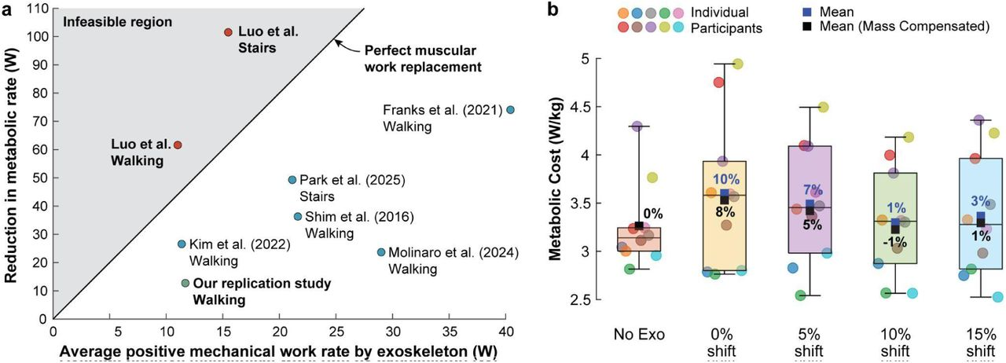
1: The results violate basic physiology
Fig 1a
Graph of mechanical work by the exoskeleton vs metabolic reduction
Most famous papers are perfectly within a reasonable range
Experiment-free Exoskeleton Assistance Via Learning In Simulation is not

Slide 12
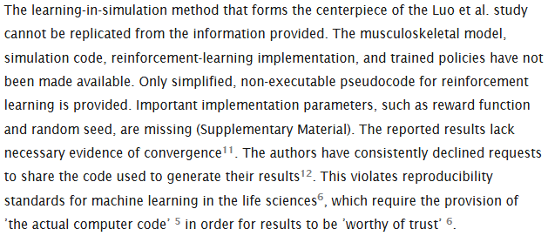
2: The exact method is unknown

Slide 13
3: A replication study found nothing
Fig 1b
Performed their own replication of the study
Did not have the actual neural network controller from original study
Instead, they
Took the average torque profile of original
Implemented it in their own hip exoskeleton under the same treadmill walking conditions
Tested 10 participants with similar demographics
Tested four offset timing variations to account for differences in heel strike

Slide 14
Key(er) takeaways
Sim-to-real transfer for exoskeleton control is a compelling but unsolved problem
Extraordinary claims require extraordinary evidence
And reproducible code
A single implausible result in a high-profile journal can mobilize an entire field to respond
Transparency and reproducibility aren't optional

Slide 15
References
Luo, S., Jiang, M., Zhang, S. et al. Experiment-free exoskeleton assistance via learning in simulation. Nature 630, 353–359 (2024). https://doi.org/10.1038/s41586-024-07382-4
Collins, S. H., De Groote, F., Gregg, R. D., Huang, H., Lenzi, T., Sartori, M., Sawicki, G. S., Si, J., Slade, P., & Young, A. J. (2026). Experiment-free learning of exoskeleton assistance remains an unsolved problem. bioRxiv. https://doi.org/10.64898/2026.04.01.715109

